Slide 1
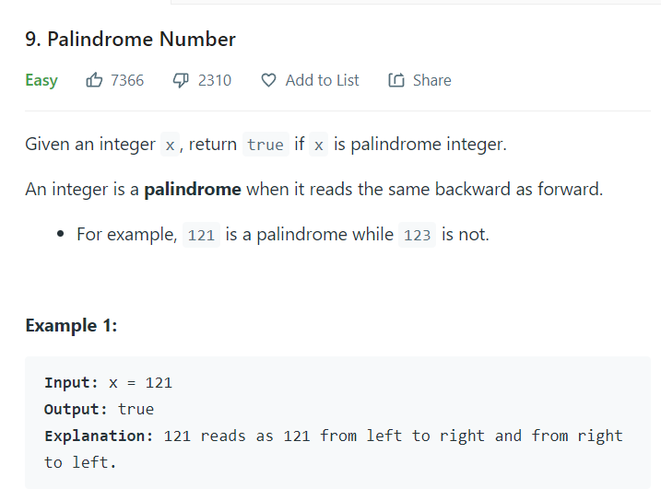
Day 2 of 100dayscodechallenge Platform - Leetcode Problem Statement:

Slide 2
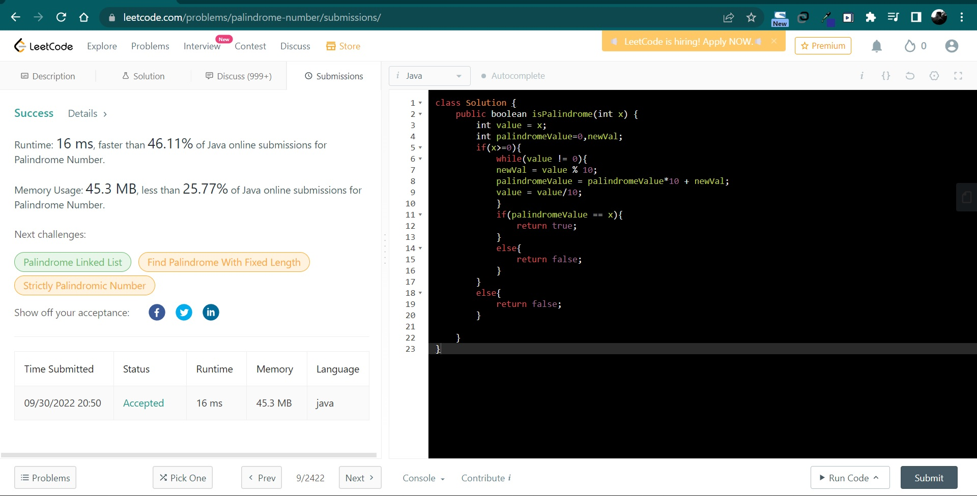
Solutions:

Slide 3
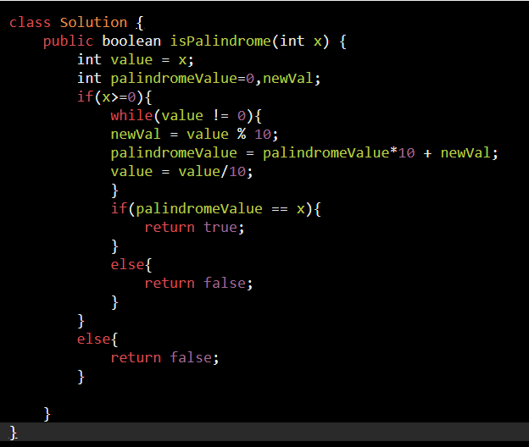
Explanation:
First we are making a copy of the variable that we getting as method argument;
We declare a variable PALINDROMEVALUE, to which we are going to store palindrome value.
We are checking if the number we received is negative or not. If negative then we are returning false otherwise we are entering inside another loop.
While loop will run until every individual value is extracted from the given integers.
Each time we are extracting single value by doing modulus of number and after that we are adding it to the PALINDROMEVALUE and then we are dividing original number by 10 to do again the same process.
We repeat the above process until the copied value becomes zero.
Then after loop ends we will check whether original value is equal to PALINDROMEVALUE.

